Slide 1

E-Commerce Customer Behavior
In this project I analyzes customer data from an e-commerce platform to uncover behavioral patterns, preferences, and factors influencing repeat purchases. Using statistical analysis and data visualization, key insights were drawn on purchase trends, device usage, delivery times, satisfaction scores, and subscription behavior. The goal is to help optimize marketing strategies, improve customer retention, and enhance overall service experience.
Presented by:
Sakib Ahmed

Slide 2
Goals:
To understand customer behavior and purchasing patterns on an e-commerce platform.
To identify key factors that influence customer satisfaction and return rates.
To generate actionable insights for improving customer engagement, retention, and sales.
Objectives:
Analyze demographic and behavioral data to find trends in purchase amount, device usage, and product preferences.
Measure satisfaction levels and evaluate the impact of delivery time, subscription type, and discounts on customer experience.
Explore the relationship between payment methods, return behavior, and review scores.
Identify high-potential customer segments and locations for targeted marketing and service improvement.

Slide 3
Basic Insights

Slide 4
Q1: Find Mean, Median, and Mode (Age)
Mean(Age): 43.7899
Median(Age): 44.0
Mode(Age): [51]
Interpretation:
Average Age is 43.79
➤ Indicates that a large number of customers are middle-aged.
Median Age is 44
➤ Suggests higher purchasing ability, as customers are likely in stable income years.
Most Frequent Age (Mode) is 51
➤ Implies many customers are in their late-career or early-retirement phase.
Recommendation:
By targeting middle aged people, Keep in stores and promote those items they like most. It can be comfortable or classic cloths, debit card, credit cards using offer etc.

Slide 5
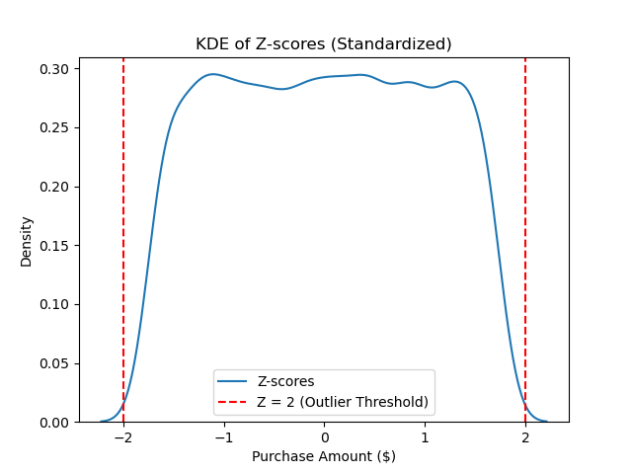
Q2: Find variance, standard deviation, and z-score (Purchase Amount)
Variance of Purchase Amount is: 81924.05
Standard Deviation of Purchase Amounts: 286.22
Interpretation:
Variance is 81,924.05 which reflects high spread in purchase amounts
A standard deviation of 286.22 is quite large. Indicates a diverse set of purchasing behaviors like some customers spend very little, some spend a lot.
Most values fall within ±2 SD, showing a consistent purchasing pattern. The flat-top shape means there have no single dominant amount density drops beyond +2 and -2, which means extreme low or extreme high purchase amount are rare

Slide 6
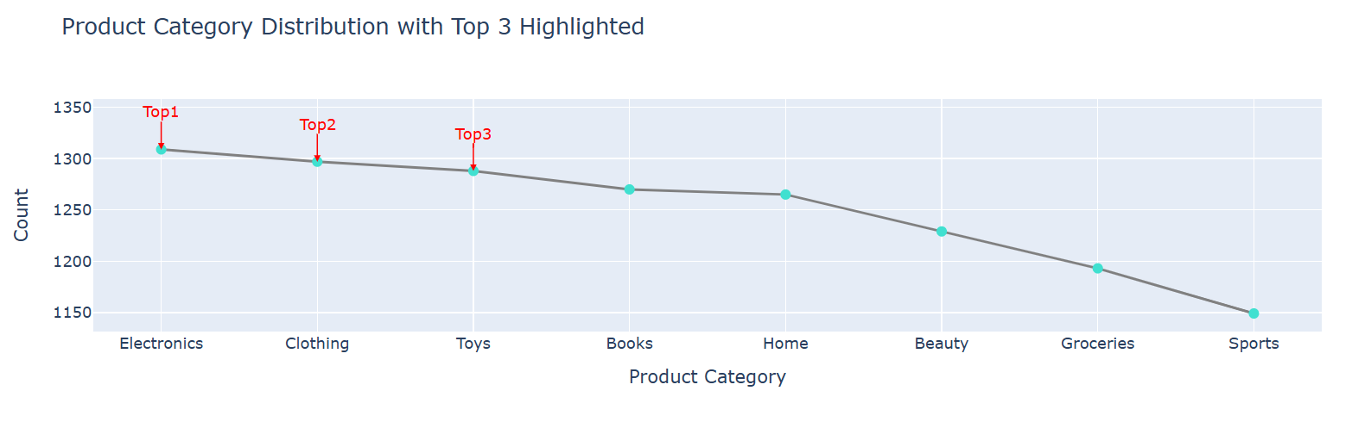
Q3: What are the top three product categories based on the number of purchases?
Interpretation:
Electronics is the most purchased category, but Clothing and Toys follow closely, showing strong interest across all three.
The close purchase counts suggest that customers often buy multiple types of products together — for example, parents buying electronics along with toys.
Beauty, Groceries, and Sports have the lowest purchases, indicating underperformance in these categories.
Recommendations:
Prioritize inventory management for the top 3 categories. Set an alert system to notify if stock falls below 10%.
Run limited-time offers for Electronics, Clothing, and Toys using seasonal promotions, style guides, or bundle deals to boost sales.
Combine top and bottom categories in bundled promotions to increase visibility and demand for underperforming items like Beauty, Groceries, and Sports.

Slide 7
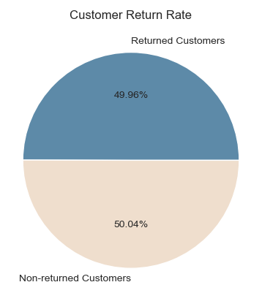
Q4: How many customers are classified as return customers?
Interpretation:
50% return rate is relatively strong, suggests Low customer satisfaction or poor experience to engagement of products
Recommendation:
Check the product quality before and after delivery. Is there any difference in the condition of the product?
Run an engagement campaign targeting customers who returned products to find out the reasons behind their returns.

Slide 8
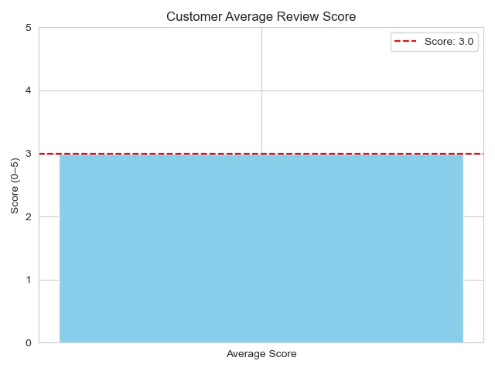
Q5: What is the average review score given by customers?
Interpretation:
A score of 3.0 is neutral, meaning customers are neither highly satisfied nor highly dissatisfied.
Unmet expectations (like, delivery, product quality)
Some variance in experiences (some good, some bad)
Recommendation:
Investigate low-scoring reviews to find consistent pain points (e.g., delivery delay, quality mismatch).Improve packaging, delivery speed, and product accuracy.
Offer a small incentive like, coupon to encourage feedback and boost scores.

Slide 9
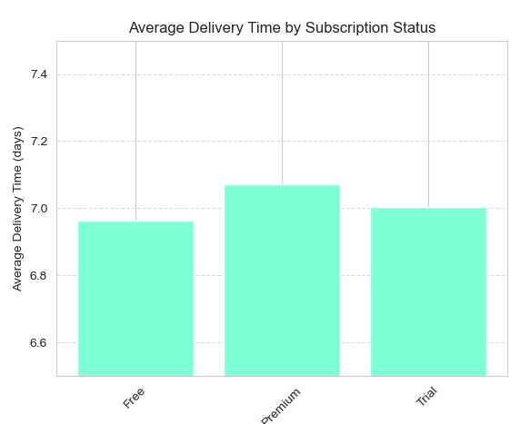
Q6: How does the average delivery time vary between subscription statuses (Free, Premium)?
Interpretation:
Premium users wait 7.07 days, which is slightly longer than free and trial users. as premium customers typically expect faster service in exchange for loyalty or fees.
Delivery time differences are nearly the same, suggesting no major prioritization for premium members. This could be a signal that a one-size-fits-all logistics approach. Which affects premium customers and reduces upgrade rates.
Recommendation:
Organize the logistics system based on the type of subscription. So that they can't mix up customers with different subscription plans.
Prioritize premium customers in the delivery pipeline by offering a faster delivery option. partners with logistic providers to expedite them.
By enhance premium value proposition, offer them Priority customer support, Free returns or handling, delivery tracking alerts.

Slide 10
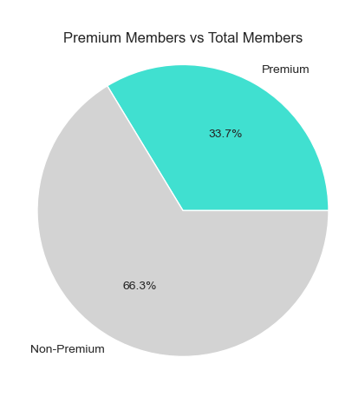
Q7: How many customers are subscribed to the service?
Interpretation:
Nearly two-thirds are not subscribed. By delivery time (~7 days), they are almost similar to premium customers; they don't need to pay any extra charge for that. This will reduce premium customers in future and feel disappointment for premium customers.
There are a huge number of customers who are free users. So that there is a chance to convert them into premium. But conversion is unlikely unless they see real value.
Recommendation:
Focus on improving delivery time, as discussed earlier.
Launch special conversion offers for standard customers to upgrade to premium, like:50% off the first month’s subscription fee
Fast delivery within 1–2 days upon upgrading to premium

Slide 11
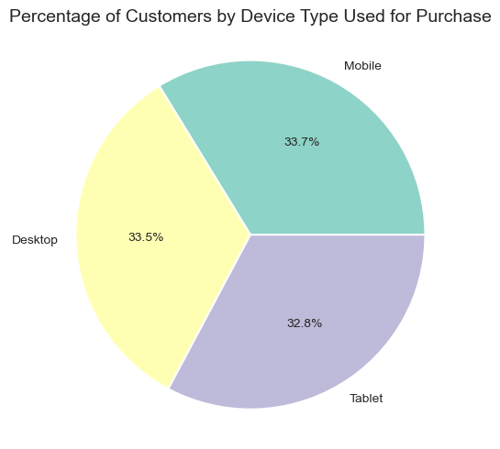
Q8: What percentage of customers used devices to make purchases? (Mobile, Desktop, Tablet)?
Interpretation:
Every device's purchase orders are nearly the same, indicating this ecommerce is reaching every tech demographic, which is good for future marketing.
33.7% users are mobile indicating growing mobile commerce (mCommerce) trend
Mainly people use desktops for more in-depth browsing or bulk ordering. Could represent older, work-time shoppers, or users preferring large screens for detailed product purchasing
32.4% tablet users indicates the need for touch-optimized, responsive layouts across all screen sizes, ich indicates that buying customers are with multiple members; possibly they are friend or family
Recommendation:
Focusing on UI/UX in every tech device for longer usability and better performance.
Increase Click-to-pay integration (Apple/Google Pay) for mobile users.
Use desktop pop-ups for larger purchases, like minimum 5 purchase ordering get 1 item free
Promote tablet-friendly bundles during holidays (used by families or kids).

Slide 12
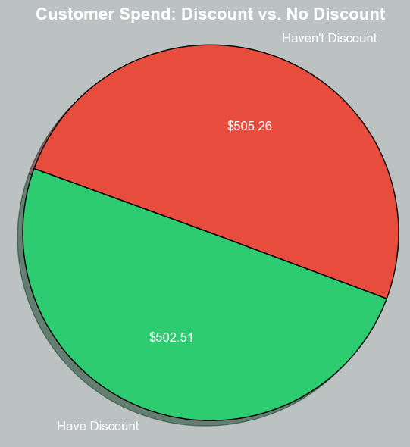
Q9: What is the average purchase amount for customers who availed discounts compared to those who didnʼt?
Interpretation:
Almost half of the customers buy from this platform when they get any discount. It indicates those free customers who don't use any premium subscription.
There a chance of new customers in the platform. There are huge chance to make them regular customers by engaging them
People comes here not for their daily needs but only when they get a discount.
Recommendation:
Purchase amounts don't increase significantly; don't give flat discounts on single products. Introduce tiered discounts or combo sales.
When newcomers buy something from this platform, offer them related things that they may need. Like, some newcomers buy a charger; suggest them to buy a ring light.
Both recommendations are not only help to consist them in the platform but also push o push beauty category which have orders

Slide 13
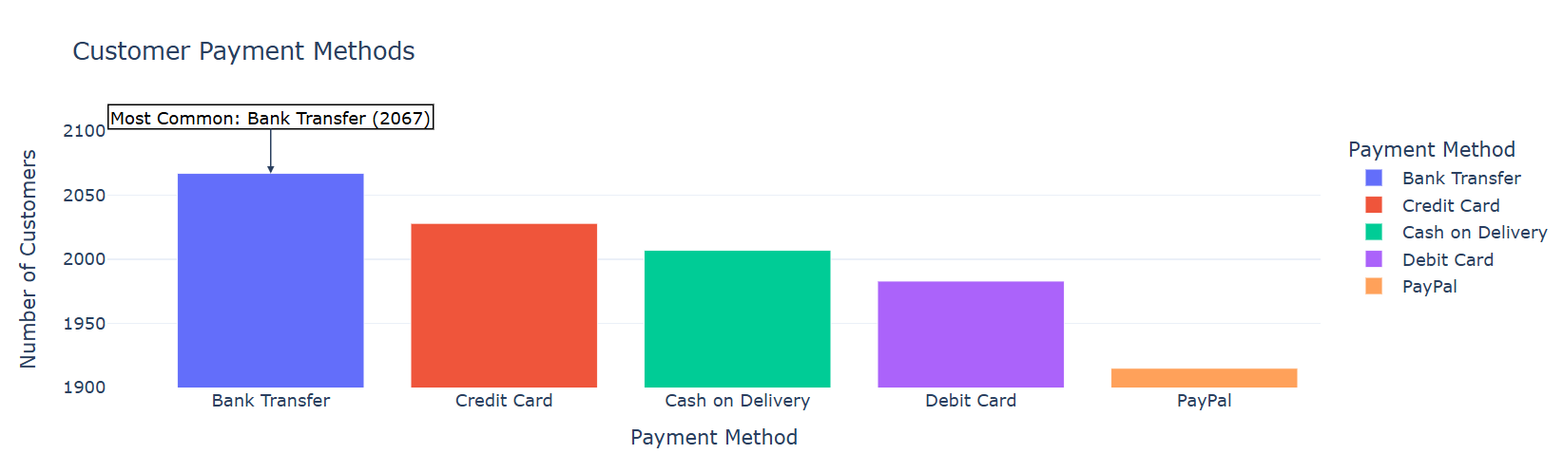
Q10: What is the most common payment method used by customers?
Interpretation:
The most common payment method is bank transfer, that the process might be favorable for customers, as they trust it more for making payments. These customers are possibly close to the median age and are tech-savvy.
Also, the PayPal payment system is slightly less popular. There is a limitation in this country or that it is too techy to use it.
Credit card users are also popular, with 39 different users, means a bunch of users are there who are familiar with "buy first, then pay." Possibly they are monthly job holders.
Recommendations:
Enhance the user experience (UX) for bank transfer users to keep them on the platform. Collaborate with the most-used banks to provide exclusive offers to these customers.
Additionally, increase engagement among credit card users by offering attractive promotions.
Consider launching special delivery offers in areas with a high concentration of workplaces, as this could lead to better conversion and lower return rates. It also helps in taking orders for office items.

Slide 14
Intermediate Insights

Slide 15
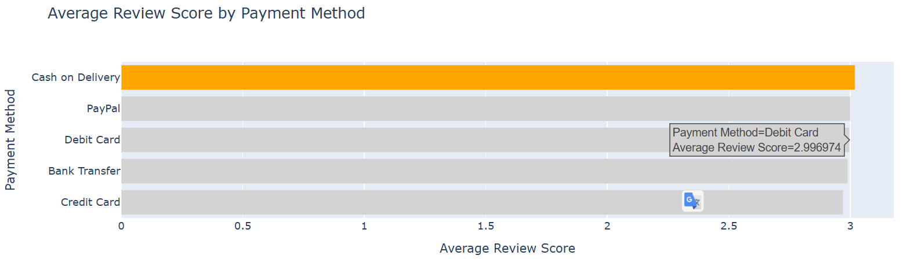
Q1: What are the average review scores of users of the most common payment method?
Interpretation:
The review score for Cash on Delivery is around 3, indicating lower customer satisfaction. These users are possibly first-time buyers. The dissatisfaction could be due to long delivery times, damaged products, or payment-related hassles.
Recommendation:
Improve the Cash on Delivery (COD) system by addressing key issues such as poor communication and delivery delays, especially for first-time customers. To build trust, highlight features like easy refunds, verified tracking, and positive customer reviews.

Slide 16
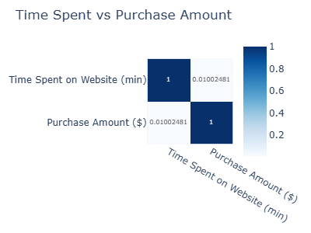
Q2: What is the correlation between time spent on the website and purchase amount? Do customers who spend more time on the website purchase more items?
Interpretation:
There is no correlation between time spent on the website and purchase amount.
Spending more time doesn’t lead to higher spending Customers are likely buying quickly, not browsing deeply.
There may be UI/UX confusing or disengagement.
Recommendation:
Improve Product recommendations:
Add Smart search, filters, and personalization by Highlighting trending or “people also bought” products

Slide 17
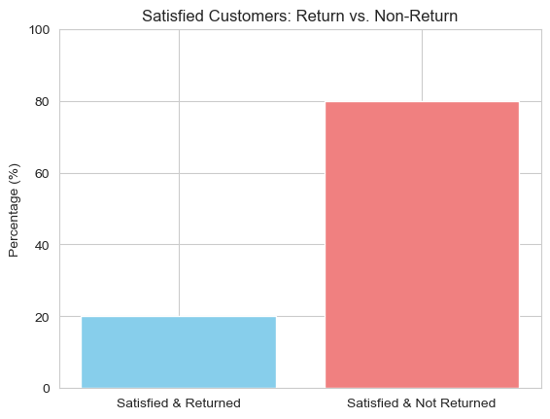
Q3: What percentage of customers are satisfied (rating of 4 or 5) and are also return customers?
Interpretation:
The percentage of satisfied and returned is only 20%, which means just 1 out of 5 customers are truly satisfied and returned their products. These customers may be from free subscription customers, whose get every advantage as like premium but they don’t get products as well they ordered
Recommendation:
Review product quality before and after delivery.
Launch a campaign to engage those unsatisfied customers.

Slide 18
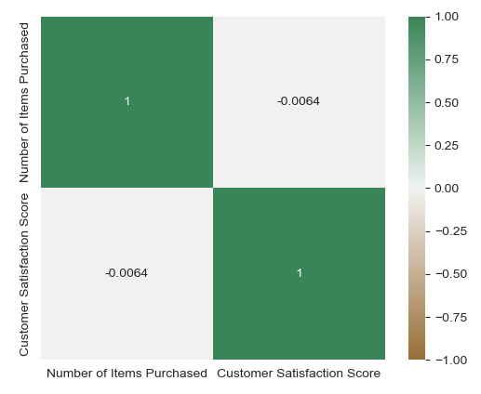
Q4: What is the relationship between the number of items purchased and customer satisfaction?
Interpretation:
There is no relation between the number of items purchased and customer satisfaction. Which means:
The number of items doesn't increase customer satisfaction
Buying more doesn’t mean they’re happy
Recommendation:
Launch a survey system to reach every customer to know about why they are not satisfied with the service.
Give them discount offers for returning back to the platform

Slide 19
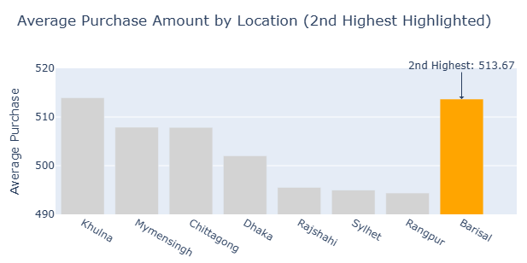
Q5: Which location has the 2nd highest average purchase amount?
Interpretation:
Barisal, being the second-highest-performing location, indicates latent potential for targeted marketing and conversion strategies. This may be driven by specific product categories or a concentration of premium customers.
The spending difference between the non-discount group and customers from this location is approximately $11. This suggests that Barisal customers are not only motivated by discounts—they may be influenced by service quality, brand experience, or exclusive membership perks that encourage higher spending.

Slide 20
Critical Thinking Insights

Slide 21
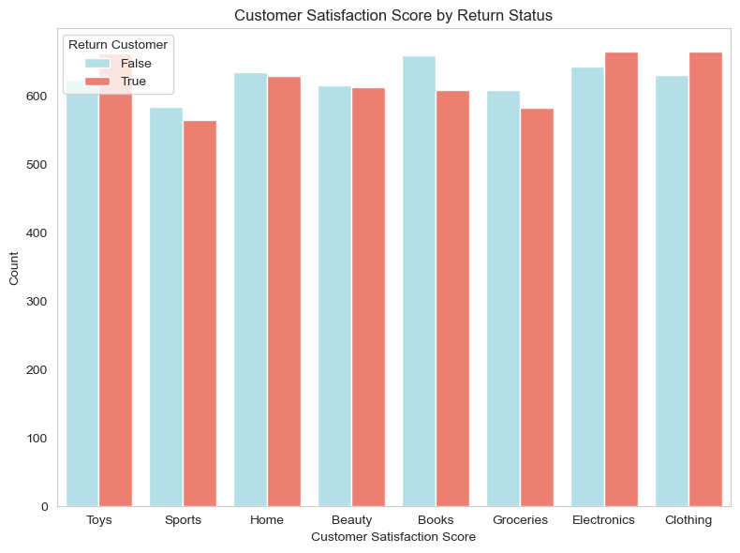
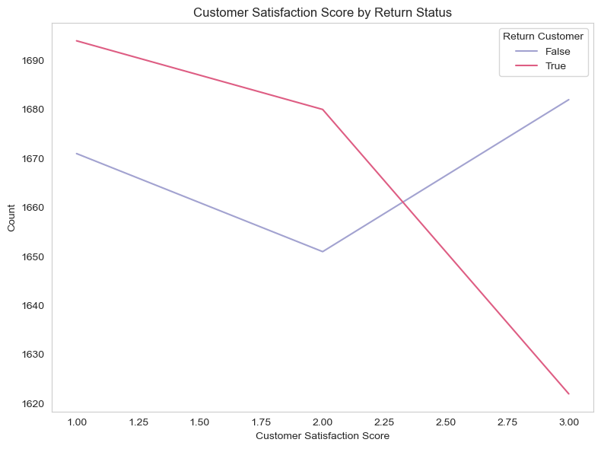
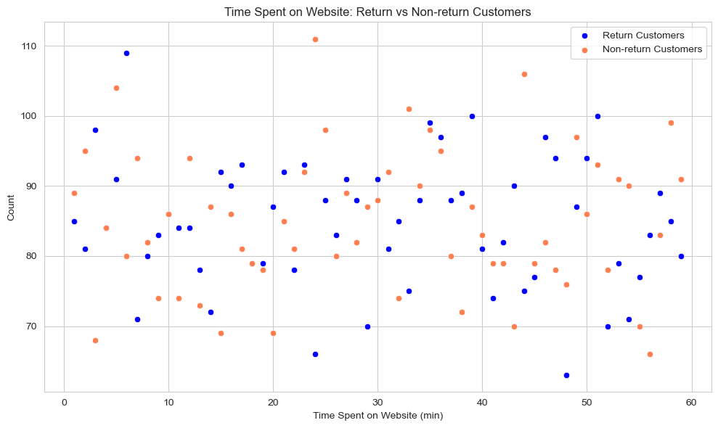
Q1: What factors contribute most to a customer being classified as a return customer?
Interpretation:
1. Product Categories: Electronics, Clothing, and Toys have the highest return rates. Electronics are sensitive, and quality issues in Toys may lead to customer dissatisfaction, increasing returns.
2. Satisfaction Score: Customers with low to medium satisfaction scores are more likely to return, showing their expectations weren’t met.
3. Website Experience: Many returned customers spent more time on the site, especially desktop users. This may suggest poor user experience or unclear value between free and premium plans.

Slide 22
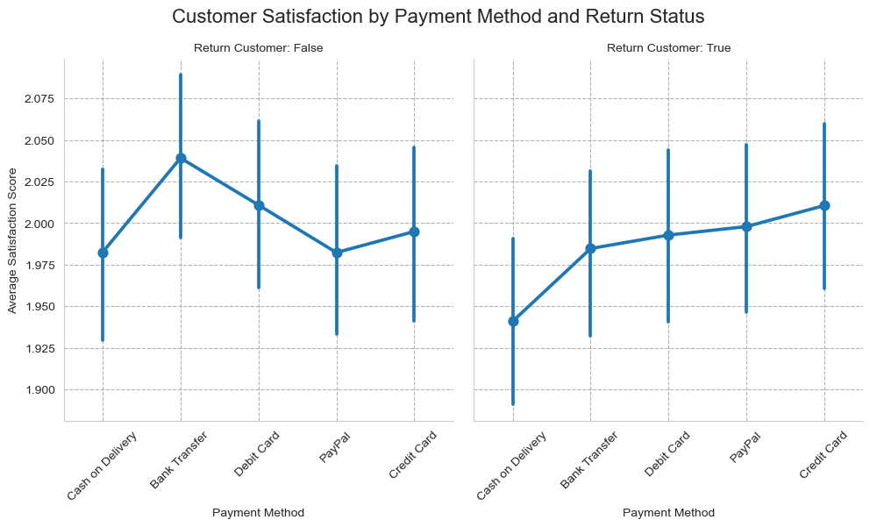
Q2: How do payment methods influence customer satisfaction and return rates?
Payment methods deeply influence customer satisfaction and return rates. like:
Except for credit card and PayPal users, for every payment method, there are higher average satisfaction scores for non-returned customers than returned. That indicated that most people are not returning for only the payment method; they have another reason. That should be delivery issues like time and quality of products.
In both cases the cash-on-delivery satisfaction score is very low. Which means this payment system has to improve and find out why it is actually performing badly.

Slide 23
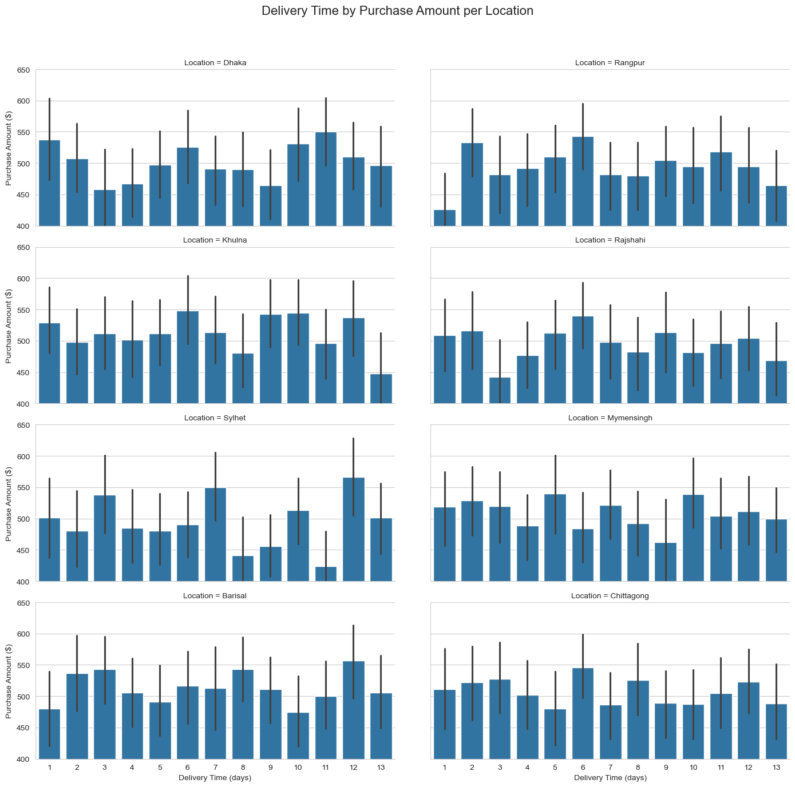
Q3: How does the location influence both purchase amount and delivery time?
Interpretation:
Barisal, Khulna, and Sylhet show relatively higher purchase amounts at longer delivery times (10–13 days).
Rangpur and Mymensingh has lower overall purchase amounts regardless of delivery time
Recommendations:
Focus Fast-Delivery Optimization in High-Spending Regions like Barisal, Khulna, and Sylhet
Also, focus on premium customers for fast delivery.
As fast delivery ≠ higher spend across all locations, don’t over-invest in fast delivery universally. Invest in a strategic location-wise logistic system.

Slide 24
Q4: What major insights are found? Give a proper explanation.
A large number of customers are middle-aged. To maximize engagement and sales, focus marketing efforts on promoting products they like
Always focus on inventory for these top 3 categories ('Electronics, 'Clothing,' and 'Toys') and promote combo offer with bottom 3 categories ('Beauty, 'Groceries,' and 'Sports')
Focus on improving delivery time, especially for premium members, and give some extra advantages to them. Because customers are unlikely to subscribe to premium unless they see real value.
Improve UI/UX in every tech device for longer usability and better performance.
Discounts don't increase orders so focus on customers actual needs, like short delivery time, quality of products etc.
There is a large lack in the delivery system. Cash on delivery has low performance in both satisfaction score and review score. Talk with the logistic team to improve the lack. Review product quality before and after delivery.
Improve product recommendations on the website and add some smart features to make them feel great.
Almost 50% of customers have returned. Improve lacking things and focus to increase satisfaction score and review score. Launching an offer doesn't increase orders but may increase the satisfaction score and review score.
Fast-delivering in high-spending regions like Barisal, Khulna, and Sylhet. Also improve lacks in lower spending areas.

Slide 25
Conclusion:
This e-commerce customer behavior analysis reveals several important insights. The average customer age is around 44, indicating a mid-aged target demographic, with 51 being the most frequent age. Electronics, Clothing, and Toys are the most purchased categories, suggesting where inventory and promotions should be focused. Mobile, Desktop, and Tablet usage are almost evenly split, highlighting the need for a seamless multi-device user experience. Although premium subscribers receive faster deliveries, the majority of customers are non-subscribers, suggesting untapped potential in converting them. Discount availing has a minor impact on average purchase amount, showing quality or convenience may matter more than price. Customer satisfaction remains low (20%) with a neutral average review score of 3.0, indicating a service or product experience gap. Bank transfers are the most used payment method, but cash-on-delivery users provide slightly better reviews. Finally, there's negligible correlation between time spent on the site or number of items purchased and satisfaction, signaling a need to focus on user journey improvements and post-purchase experience.

